Slide 1
Variables & Data Types
Week 1, Day 3

Slide 2
Objects
Programs work with data.

Slide 3
Objects
Programs work with data.
Every piece of data in Python is called an object.

Slide 4
Objects
Programs work with data.
Every piece of data in Python is called an object.
Every object has a type.

Slide 5
Objects
Programs work with data.
Every piece of data in Python is called an object.
Every object has a type.
Imagine the python zoo:
Every time an object is created, an animal is created.
What an animal can do depends on the type of the animal.
Birds can fly, fish can swim, elephants can lift etc.
Notes:
Object oriented programming.
But different objects can do different things. Imagine a zoo as an example.

Slide 6
Using Objects-Numbers
Simply write them.
13
3.141592
-5
3 + 6j
All automatically number objects!

Slide 7
Using Objects - Strings
Surrounded by “ and “ to make a string object. (‘ and ‘ are ok too)
“I love this class!”
“Strings, how wonderful!”
“3.1415”
All automatically string objects if surrounded by “ ” or ‘ ‘.

Slide 8
Using Objects - Booleans
Truth Values - only two possible values.
True
False
Note the capitalisation!

Slide 9
Giving names to objects
String examples:
message1 = “I love computer science!”
message2 = “I hate computer science!”
Number examples:
student_id = 20153813
age = 23

Slide 10
Naming rules
special rules: cannot use def, if, else, while, True, False.
Letters, digits, underscores(_).
First character should not be a digit.
Case-sensitive.

Slide 11
Spot the errors!!! (2 errors)
more@ = “ok or not”
message = “def”
Else = 39912
while = True

Slide 12
Spot the errors!!!
more@ = “ok or not”
message = “def”
Else = 39912
while = True

Slide 13
Spot the errors!!! (2 errors)
comp_ut3r = 3.33
_hello = “hello”
hello_ = “hello”
3hello = “hello”
True = “while”

Slide 14
Spot the errors!!!
comp_ut3r = 3.33
_hello = “hello”
hello_ = “hello”
3hello = “hello”
True = “while”

Slide 15
Different types
What an object can do is determined by its type.
We can’t do:
Hubo + hubo
Hubo - Hubo
We can do:
1 + 2
1 - 2

Slide 16
Names and Variables
Names are also called variables.
Can be given different values.

Slide 17
Names and Variables
Names are also called variables.
Can be given different values.
N = 1

Slide 18
Names and Variables
Names are also called variables.
Can be given different values.
N = 1
M = 3

Slide 19
Names and Variables
Names are also called variables.
Can be given different values.
N = 1
M = 3
N = 8

Slide 20
Names and Variables
Names are also called variables.
Can be given different values.
N = 1
M = 3
N = 8
M = N

Slide 21
Names and Variables
Names are also called variables.
Can be given different values.
N = 1
M = 3
N = 8
M = N
M = M + 1
What are M and N?

Slide 22
Names and Variables
Names are also called variables.
Can be given different values.
N = 1
M = 3
N = 8
M = N
M = M + 1
What are M and N?
Answer:
N = 8
M = 9

Slide 23
Names and Variables
Names are also called variables.
Can be given different values.
N = 1
M = 3
N = 8
M = N
M = M + 1
N = “hi”
What are M and N?
Notes:
Can also assign different objects to the same variable.

Slide 24
Names and Variables
Names are also called variables.
Can be given different values.
N = 1
M = 3
N = 8
M = N
M = M + 1
N = “hi”
What are M and N? N = “hi”, M = 9
Notes:
Can also assign different objects to the same variable.

Slide 25
Methods
Objects perform actions through methods.
Methods are called using the dot syntax.
hubo = Robot()
hubo.move()
hubo.turn_left()
hubo.dance()

Slide 26
Numbers have special methods
Methods of numbers are accessed through operators.
+, - , * , / , // , % , **
* - multiplication
3 * 2 (=6)
-2 * 3 (=-8)

Slide 27
Numbers have special methods
Methods of numbers are accessed through operators.
+, - , * , / , // , % , **
/ - division
3 / 2 (=1.5)
6/3 (=2)
9/7 (=1.2857142857)

Slide 28
Numbers have special methods
Methods of numbers are accessed through operators.
+, - , * , / , // , % , **
// - integer division
3//2 (=1)
7//3 (=2)

Slide 29
Numbers have special methods
% - Remainder
7%2 (=1)
2%2 (=0)

Slide 30
Numbers have special methods
% - Remainder
7%2 (=1)
2%2 (=0)
** - power
2**3 (=8)
1**7 (=1)

Slide 31
Numbers have special methods
Expressions
Combination of objects, variables, operators and function calls.

Slide 32
Numbers have special methods
Expressions
Combination of objects, variables, operators and function calls.
Example:
3.0 * (2 ** 3 – 12/4) + 4**2
Can anyone figure out the answer?

Slide 33
Numbers have special methods
Expressions
Combination of objects, variables, operators and function calls.
Example:
3.0 * (2 ** 3 – 12/4) + 4**2
Can anyone figure out the answer?
Answer: 31

Slide 34
Boolean Expressions
Expression that evaluates to True or False.
New operators:
<=, >=, ==, !=, < , >
All these return True or False.
Don’t confuse with =

Slide 35
Boolean Expressions
3<5

Slide 36
Boolean Expressions
3<5
True

Slide 37
Boolean Expressions
3<5
True
27 == 14

Slide 38
Boolean Expressions
3<5
True
27 == 14
False

Slide 39
Boolean Expressions
3<5
True
27 == 14
False
3.14 != 3.14

Slide 40
Boolean Expressions
3<5
True
27 == 14
False
3.14 != 3.14
False

Slide 41
Boolean Expressions
3<5
True
27 == 14
False
3.14 != 3.14
False
“3” == 3

Slide 42
Boolean Expressions
3<5
True
27 == 14
False
3.14 != 3.14
False
“3” == 3
False

Slide 43
Conditionals
Often a program must make a decision depending on the environment.

Slide 44
Conditionals
Often a program must make a decision depending on the environment.
How do we make a program do this?
If it rains, hubo studies.
It it doesn’t rain, hubo dances.

Slide 45
Boolean- True and False
We learned this last lecture!
Boolean types
True
False
not- reverse of true/false

Slide 46
Conditionals
Often a program must make a decision depending on the environment.
How do we make a program do this?
if(it rains):
hubo.study
else:
hubo.dance
If it rains, hubo studies.
It it doesn’t rain, hubo dances.

Slide 47
Conditionals
Often a program must make a decision depending on the environment.
How do we make a program do this?
Condition
if(it rains):
hubo.study
else:
hubo.dance
If it rains, hubo studies.
It it doesn’t rain, hubo dances.

Slide 48
Conditionals
Often a program must make a decision depending on the environment.
How do we make a program do this?
Condition
if(it rains):
hubo.study
else:
hubo.dance
If it rains, hubo studies.
It it doesn’t rain, hubo dances.
If condition is true, do this.

Slide 49
Conditionals
Often a program must make a decision depending on the environment.
How do we make a program do this?
Condition
if(it rains):
hubo.study
else:
hubo.dance
If it rains, hubo studies.
It it doesn’t rain, hubo dances.
If condition is true, do this.
If condition is false, do this.

Slide 50
More versions of conditionals
What if we have only one condition?
We don’t always need to use else.

Slide 51
More versions of conditionals
What if we have only one condition?
We don’t always need to use else.
if(it rains):
Hubo.study

Slide 52
More versions of conditionals
What if we have several conditions?

Slide 53
More versions of conditionals
What if we have several conditions?
if(it rains):
Hubo.study
elif(it snows):
Hubo.sleep
elif(it is windy):
Hubo.watch_tv
else:
hubo.dance
elif = else if

Slide 54
Quiz
Can you predict what the output will be?
if 1<2:
print(“I love computer science!”)
else:
print(“I hate computer science!”)

Slide 55
Quiz
Can you predict what the output will be?
if False:
print(“I love apples!”)
else:
print(“I love bananas!”)

Slide 56
Solution-1
How can hubo move to 10 and pick up these beepers along the way?
Possible solution?
hubo.move()
hubo.pick_beeper()
X 9

Slide 57
Hubo can do more complex things now!
How can hubo move to 10 and pick up these beepers along the way?
Possible solution?
hubo.move()
hubo.pick_beeper()
X 9
What if there is no beeper?

Slide 58
Hubo can do more complex things now!
New solution using conditionals:
hubo.move()
If hubo.on_beeper():
hubo.pick_beeper()
X 9

Slide 59
Let’s simplify things- define a function!
hubo.move()
If hubo.on_beeper():
hubo.pick_beeper()
def move_and_pick():
hubo.move()
if hubo.on_beeper():
hubo.pick_beeper()

Slide 60
Let’s simplify things- define a function!
Newer solution:
hubo.move_and_pick()
X 9

Slide 61
Result

Slide 62
Summary
Objects
Data types
String
Number
Methods
Operators
Boolean Expressions
Conditionals using if, else, elif

Slide 63
Lab Session
Week 1, Day 3

Slide 64
Printing and Scanning
We learned about printing messages to the screen
print(“Hello Students!”)
How do we get user input?
Use input()
name = input(“What is your name?”)
1. This will be printed.
2. Computer will wait for keyboard input.
3. Name variable will contain keyboard input.

Slide 65
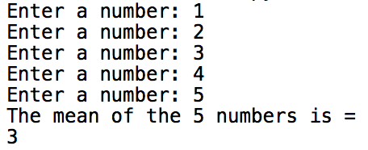
Task 1- mean calculator
Create a simple mean calculator.
Instructions:
Receive 5 numbers from the user using input().
The message should be: “Enter a number: ”
Store the 5 numbers in 5 different variables.
Calculate the mean of the 5 numbers.
Print the mean to the screen.
The message should be: “The mean of the 5 numbers is ___. ”

Slide 66
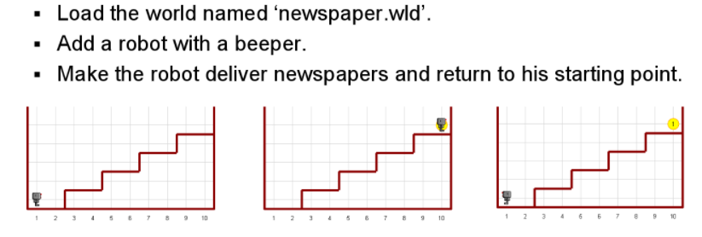
Task 2 – Newspaper Delivery
hubo = Robot(beepers = 1)

Slide 68
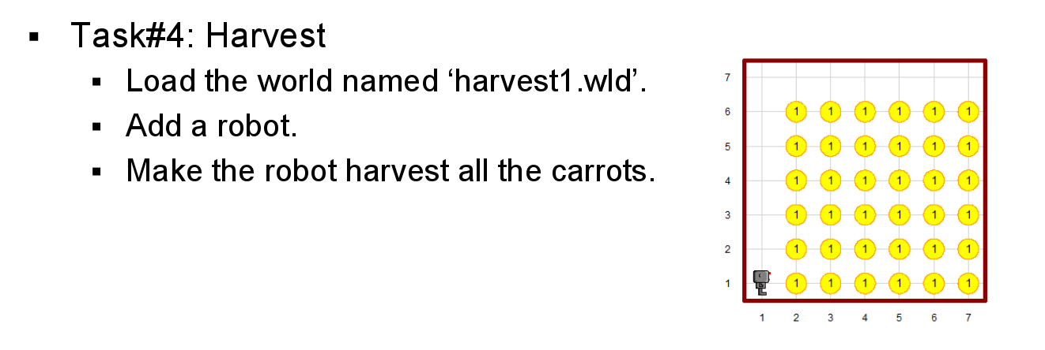
Task 3

Slide 69
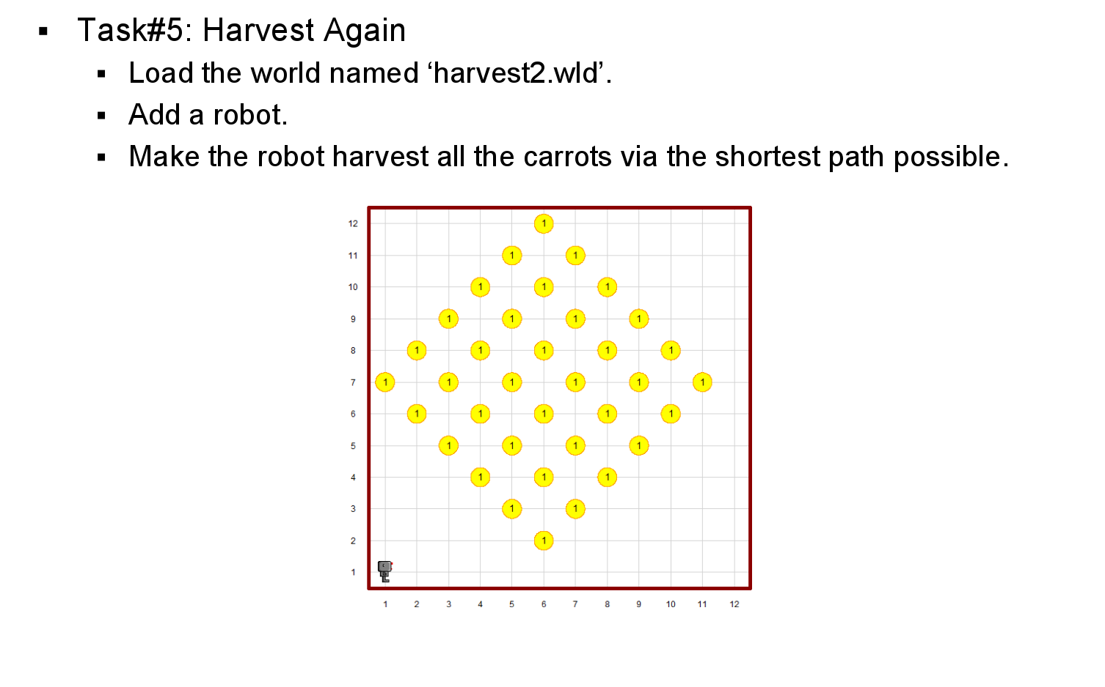
Task 4

Slide 70
Good luck!

